Slide 1
Install Kubernetes
Lecturer: Ngo Huy Bien
Software Engineering Department
Faculty of Information Technology
VNUHCM - University of Science
Ho Chi Minh City, Vietnam
nhbien@fit.hcmus.edu.vn

Slide 2

Objectives

Slide 3

Contents

Slide 4

References

Slide 5
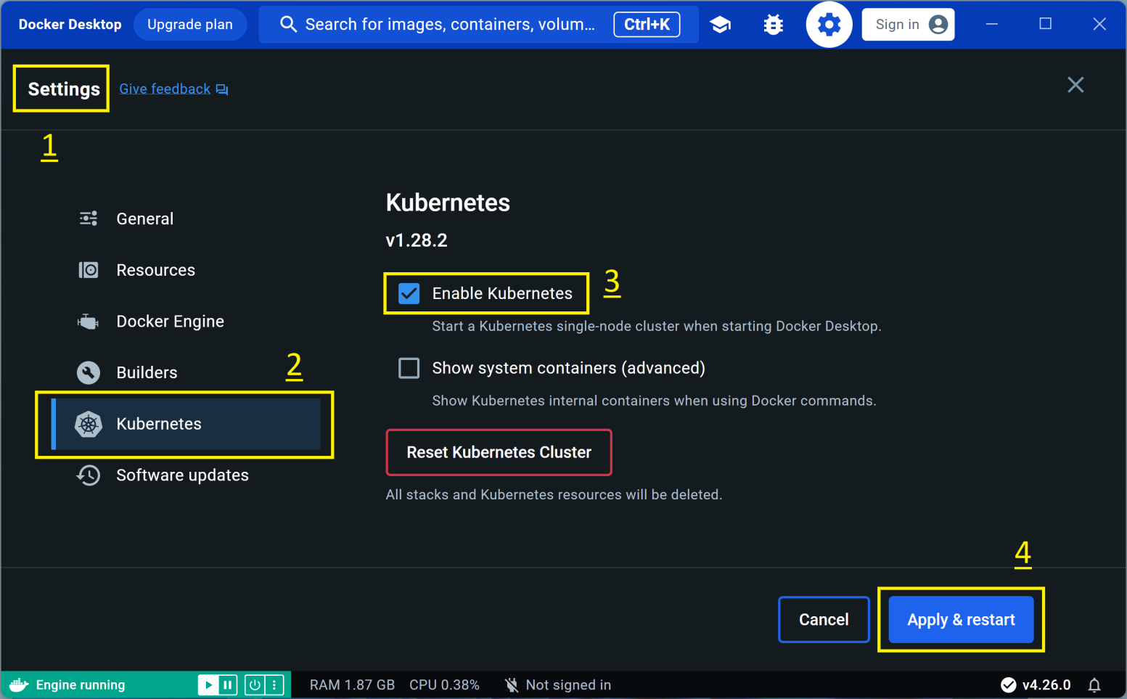
1. Enable Docker Desktop Kubernetes

Slide 6
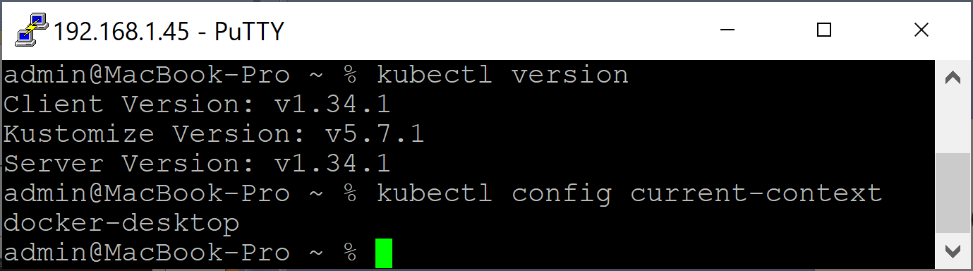
2. Verify Version
kubectl version
# make sure your kubeconfig context is set to docker-desktop:
kubectl config current-context

Slide 7
Issue: The connection to the server 127.0.0.1:6443 was refused
The connection to the server 127.0.0.1:6443 was refused - did you specify the right host or port?
Solution: Start Docker.

Slide 8
Issue: Unable to connect to the server: tls
Unable to connect to the server: tls: failed to verify certificate: x509: certificate signed by unknown authority…
Solution:
sudo rm -rf $HOME/.kube/
# Then click "Reset Kubernetes Cluster" button.

Slide 9


Slide 10
minikube
minikube is local Kubernetes, focusing on making it easy to learn and develop for Kubernetes.
All you need is Docker (or similarly compatible) container.
minikube runs in a VM.
NodePort and ClusterIP behave like real clusters.
NodePort: access via VM IP + nodePort.

Slide 11
Docker Desktop Kubernetes
Networking is less "real-world".
NodePorts are not reachable on localhost by default.
Kubernetes traffic often routes via internal Docker networks.
kubectl port-forward is the most reliable way to access workloads.

Slide 12
1. Install minikube on macOS
https://minikube.sigs.k8s.io/docs/start/
curl -LO https://github.com/kubernetes/minikube/releases/latest/download/minikube-darwin-arm64
sudo install minikube-darwin-arm64 /usr/local/bin/minikube

Slide 13
2. Start minikube Cluster
https://minikube.sigs.k8s.io/docs/drivers/
minikube can be deployed as a VM, a container, or bare-metal.
https://minikube.sigs.k8s.io/docs/drivers/docker/
# Open Docker Desktop on macOS:
open -a Docker
# Start a cluster using the docker driver:
minikube start --driver=docker
# To make docker the default driver:
minikube config set driver docker

Slide 14
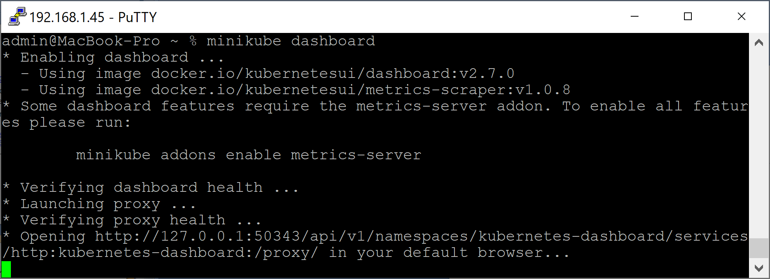
3. Test the Cluster
https://minikube.sigs.k8s.io/docs/start/
kubectl get po -A
minikube dashboard

Slide 15
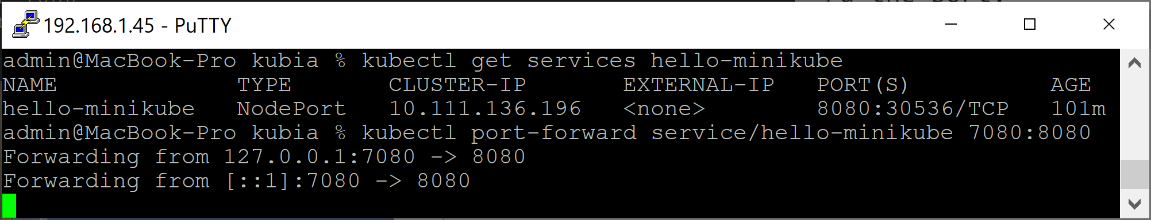
4. Hello minikube
kubectl create deployment hello-minikube --image=kicbase/echo-server:1.0
kubectl expose deployment hello-minikube --type=NodePort --port=8080
kubectl get services hello-minikube
# use kubectl to forward the port:
kubectl port-forward service/hello-minikube 7080:8080

Slide 16
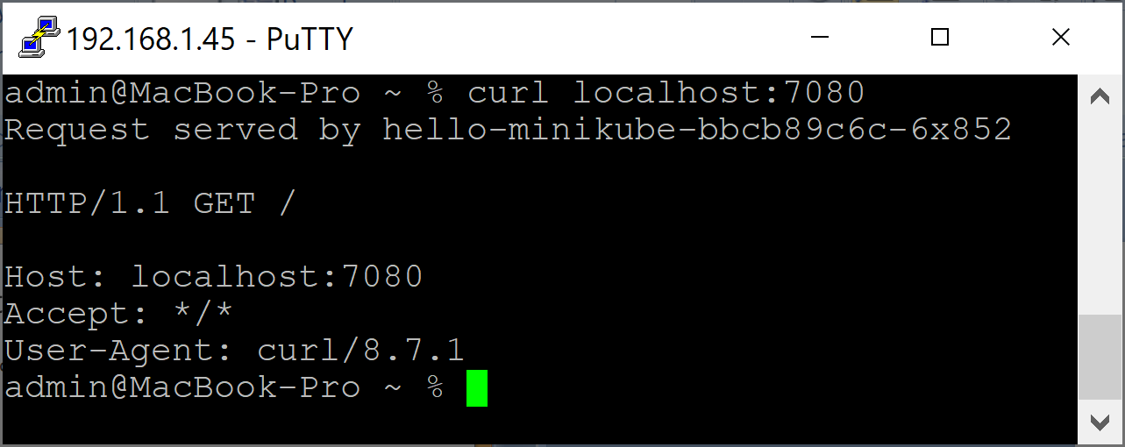
5. Test Your Cluster
curl localhost:7080

Slide 17
6. Reset Your Cluster
minikube stop
minikube delete

Slide 19
1. Start minikube with 20GB RAM
Open Docker Desktop.
Go to Settings >> Resources.
Increase Memory.
Apply and restart Docker.
# Tell Minikube to use 20 GB of RAM with the default driver
minikube config set memory 20480
minikube delete
# Tell Minikube to use 20 GB of RAM with the Docker driver
minikube start --driver=docker --memory=20480
minikube config set driver docker

Slide 20
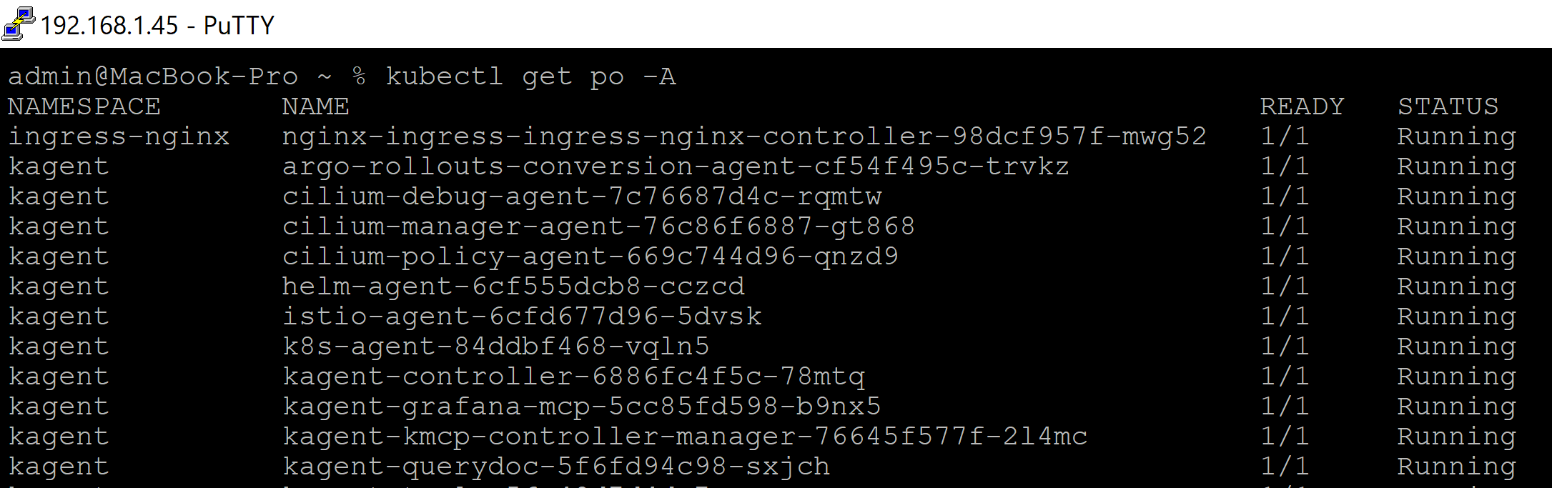
2. Test the Cluster
kubectl get po -A

Slide 22
k3d
https://k3d.io/v5.7.4/
k3d is a lightweight wrapper to run k3s (Rancher Lab’s minimal Kubernetes distribution) in docker.
k3d makes it very easy to create single- and multi-node k3s clusters in docker, e.g. for local development on Kubernetes.

Slide 23
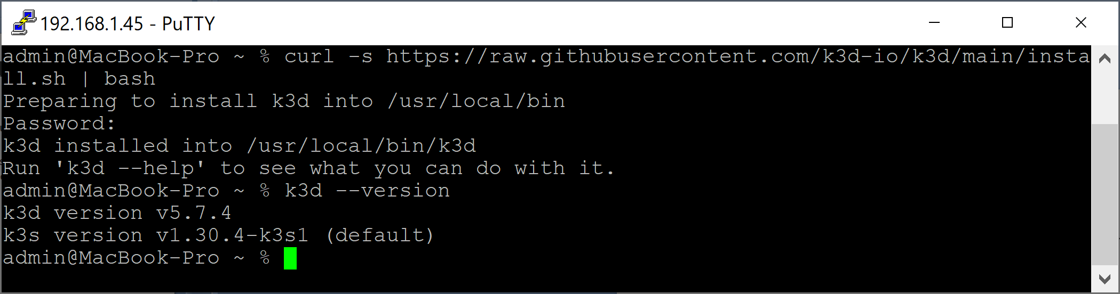
1. Install k3d on macOS
curl -s https://raw.githubusercontent.com/k3d-io/k3d/main/install.sh | bash
k3d --version

Slide 24
2. Uninstall k3d on macOS
sudo rm $(which k3d)

Slide 26
kind
https://kind.sigs.k8s.io/
kind is a tool for running local Kubernetes clusters using Docker container "nodes".
kind was primarily designed for testing Kubernetes itself, but may be used for local development or CI.

Slide 27
kind and minikube
kind prioritizes orchestration efficiency and test fidelity.
Containerized, multi-node possible.
Use cases: CI, testing, Kubernetes internals.
minikube prioritizes environmental realism and usability.
Stronger isolation, typically single-node.
Use cases: Local development, learning.

Slide 28
kind and k3d
kind keeps the full Kubernetes behavior at the cost of higher resource use.
k3d trades some completeness for efficiency.

Slide 30
1. Install minikube on Ubuntu
https://minikube.sigs.k8s.io/docs/start
curl -LO https://github.com/kubernetes/minikube/releases/latest/download/minikube-linux-amd64
sudo install minikube-linux-amd64 /usr/local/bin/minikube && rm minikube-linux-amd64
sudo usermod -aG docker $USER && newgrp docker
minikube start

Slide 31
2. Install kubectl
https://kubernetes.io/docs/tasks/tools/install-kubectl-linux/
curl -LO "https://dl.k8s.io/release/$(curl -L -s https://dl.k8s.io/release/stable.txt)/bin/linux/amd64/kubectl"
sudo install -o root -g root -m 0755 kubectl /usr/local/bin/kubectl
kubectl version --client

Slide 32

Thank You & See You Again

